Slide 1
Student Hub
Team members:
Vidisha Sawant
Prashant Shinde
Neerav Poriya
Raj Mehta

Slide 2
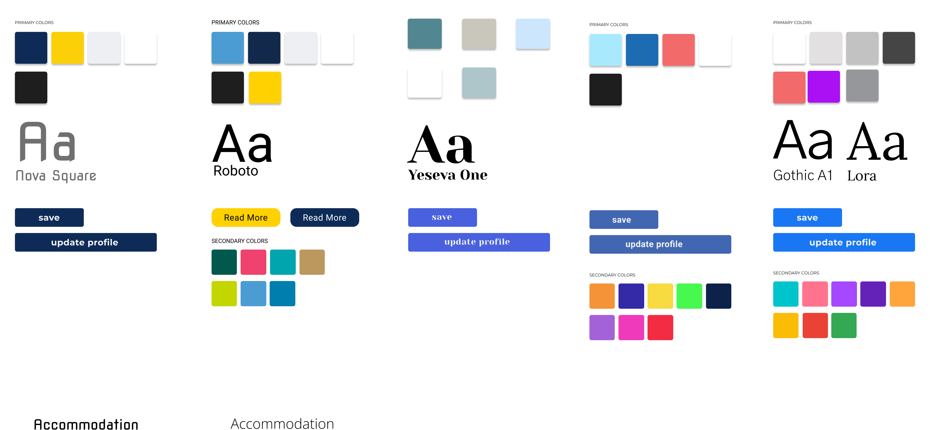
Our aim is to create an agnostic application to help cater needs of international students. Through this application, we try and answer the most common questions and doubts people have in relation to various things like accommodation, opening bank accounts, obtaining SSNs and university events, etc.
We started of by assigning each person on the team to produce color schema for the website and we then followed the voting system and selected our second design from left to be our color scheme.
For the web application font, we went with “Roboto” and “Open Sans”.

Slide 3
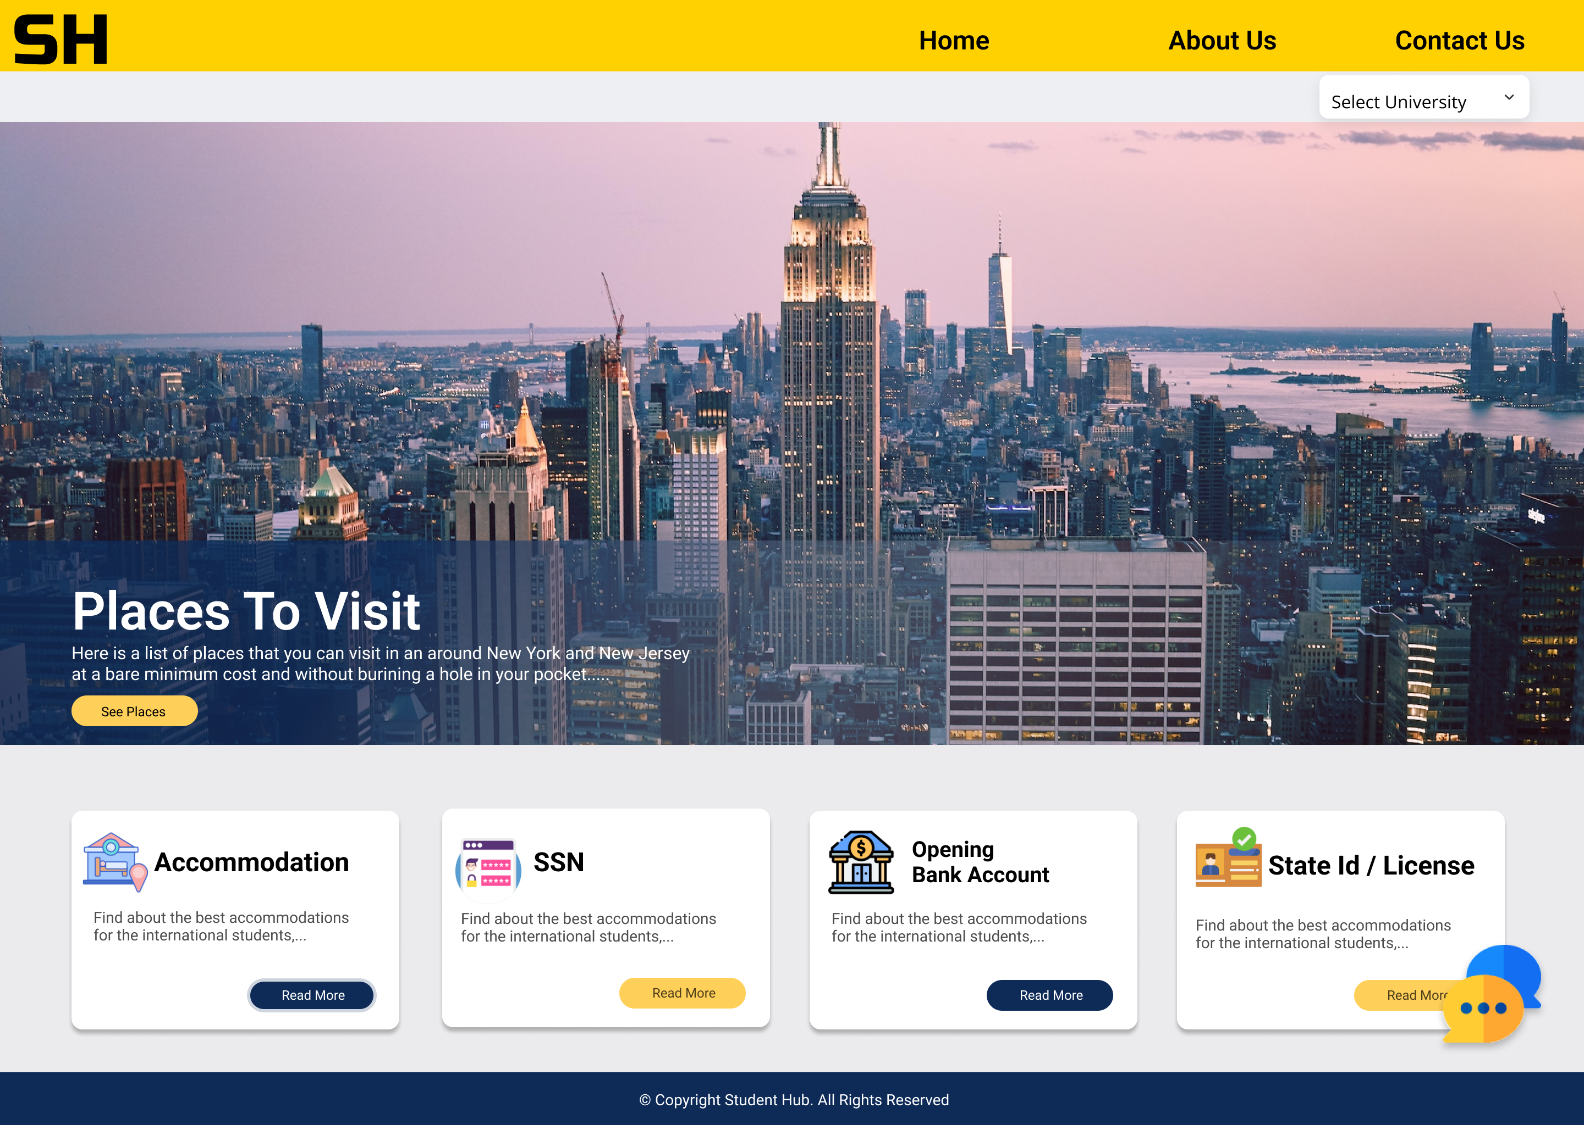
Home Page
We have tried to keep the design simple and club all the common task together, where a student can interact with the website for common tasks which are not university centric. After Interviews and Survey, the 5 common task that we produced were Places to visit, Accommodation, SSN, Opening Bank Account, State Id / License.
In the header too we have only 3 things Home, About Us and Contact Us section.
We do have a chat feature, which acts as a chat bot and if the answers are not available, then one can leave query and it will be answered within timeframe of 48 hours.

Slide 4
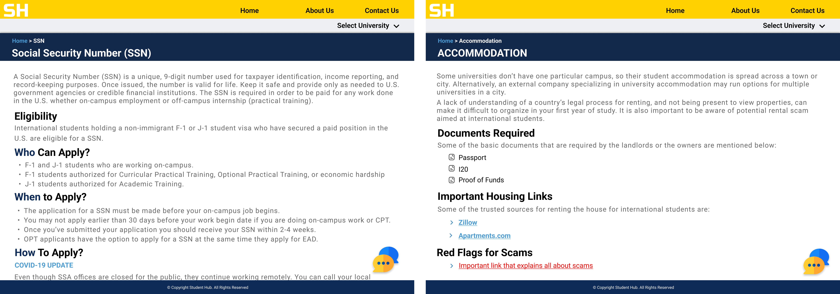
SSN
Accommodation
Student is redirected to SSN page from the home page on click of read more button.
All the details related to Who, When & How are defined in the page.
Student is redirected to Accommodation page from the home page on click of read more button.
Detail related to documents that are generally required, Housing website links and how to avoid Scams.

Slide 5
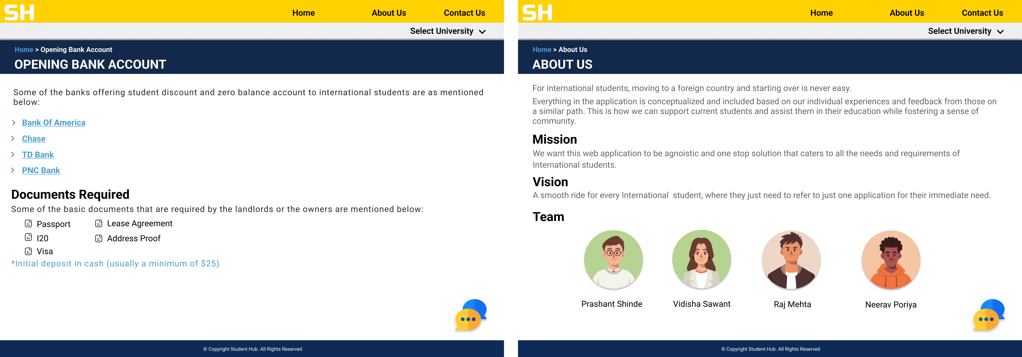
Opening Bank Account
About Us
Redirects to the checking account pages for student’s page for individual banks
It also describes about the documents required for opening of bank account.
This page talks about the idea behind the application, our Mission, Vision and then introduces users to the Team.

Slide 6
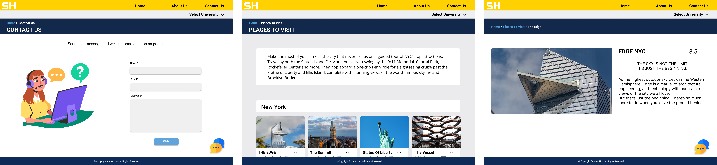
Contact Us
Places To Visit
It consists of basic form to submit queries and they will be answered within 48 hours.
Places to Visit, shows all the places that are famous and near around New York and New Jersey that are affordable and a bit budget friendly.

Slide 7
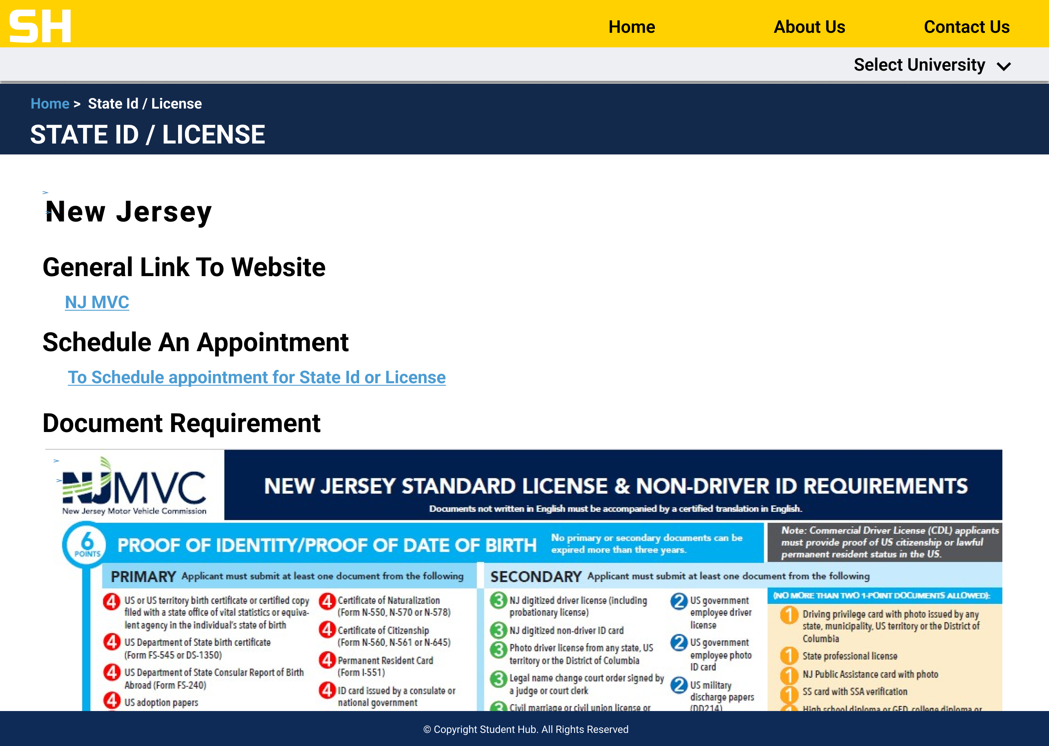
State Id / License
This page gives details about New Jersey and New York license and state Id document requirement and appointment booking link. It also has image showcasing the document requirement and the points associated with it.

Slide 8
University-Centric Tasks
We have tried to keep the design simple and club all the common tasks together, where a student can interact with the website for common tasks which are university centric. After Interviews and Surveys, the 4 common tasks that we came up with were mentorship program, On- Campus, events, and Immunization.
In the header, we have only 3 things Home, About Us, and Contact Us section.

Slide 9
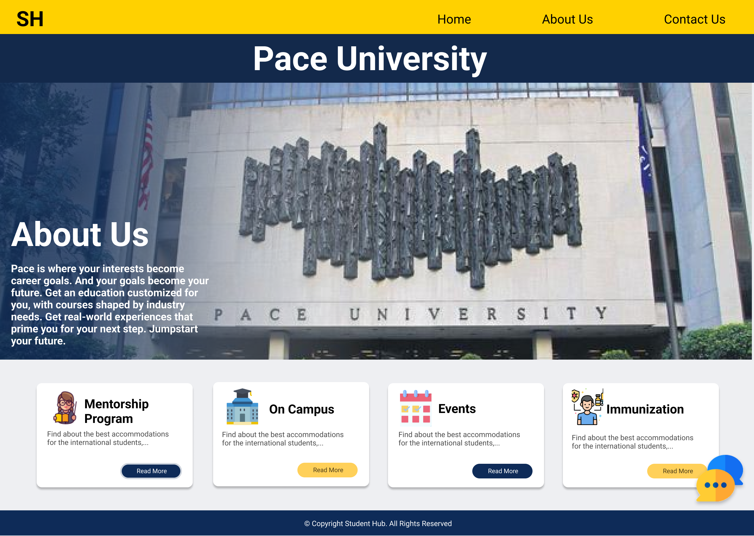

Slide 10
Mentorship program: The page help students with some of the most common tasks they need but don’t know how to proceed with it. The mentorship program consists of 3 sub-parts: Bank: The Bank details consist of which are the most common banks for students in the USA, what documents are required, and how links how can they schedule an appointment. Loan: The Loan details consist of the procedure of applying for the loan in India, who is eligible for applying for a loan, and also what documents are required for the loan. The details also consist of what all various banks cover in their loan. Money transfer to India: The Students who start earning on-campus or get an internship and decide to send money to their loved ones or to repay the loan as soon as possible can send money using Remitly which is most used in the US for sending money to India.

Slide 11
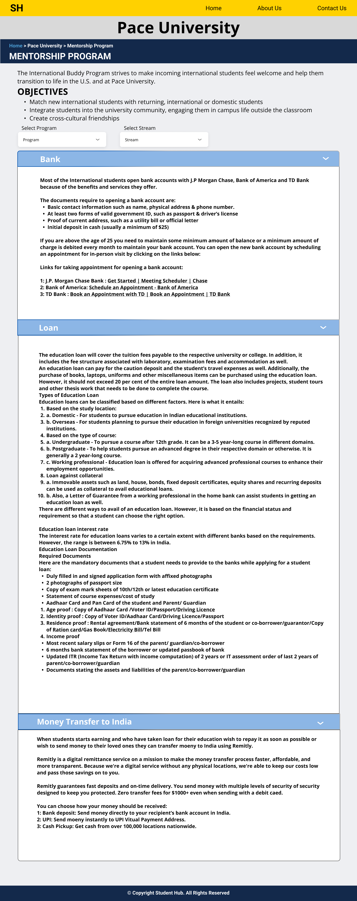

Slide 12
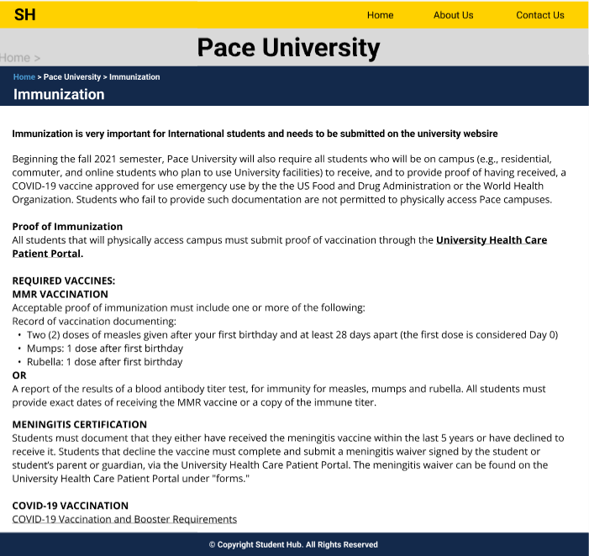
Immunization
The immunization page consists of the details on how you can complete your immunization procedure and what documents are needed and which medical proof is required to change your immunization status to complete as well as the university health care link.

Slide 13

On–Campus
The On Campus gives details about where the students can apply for the opportunities and what types of opportunities are available for student on – campus.

Slide 14
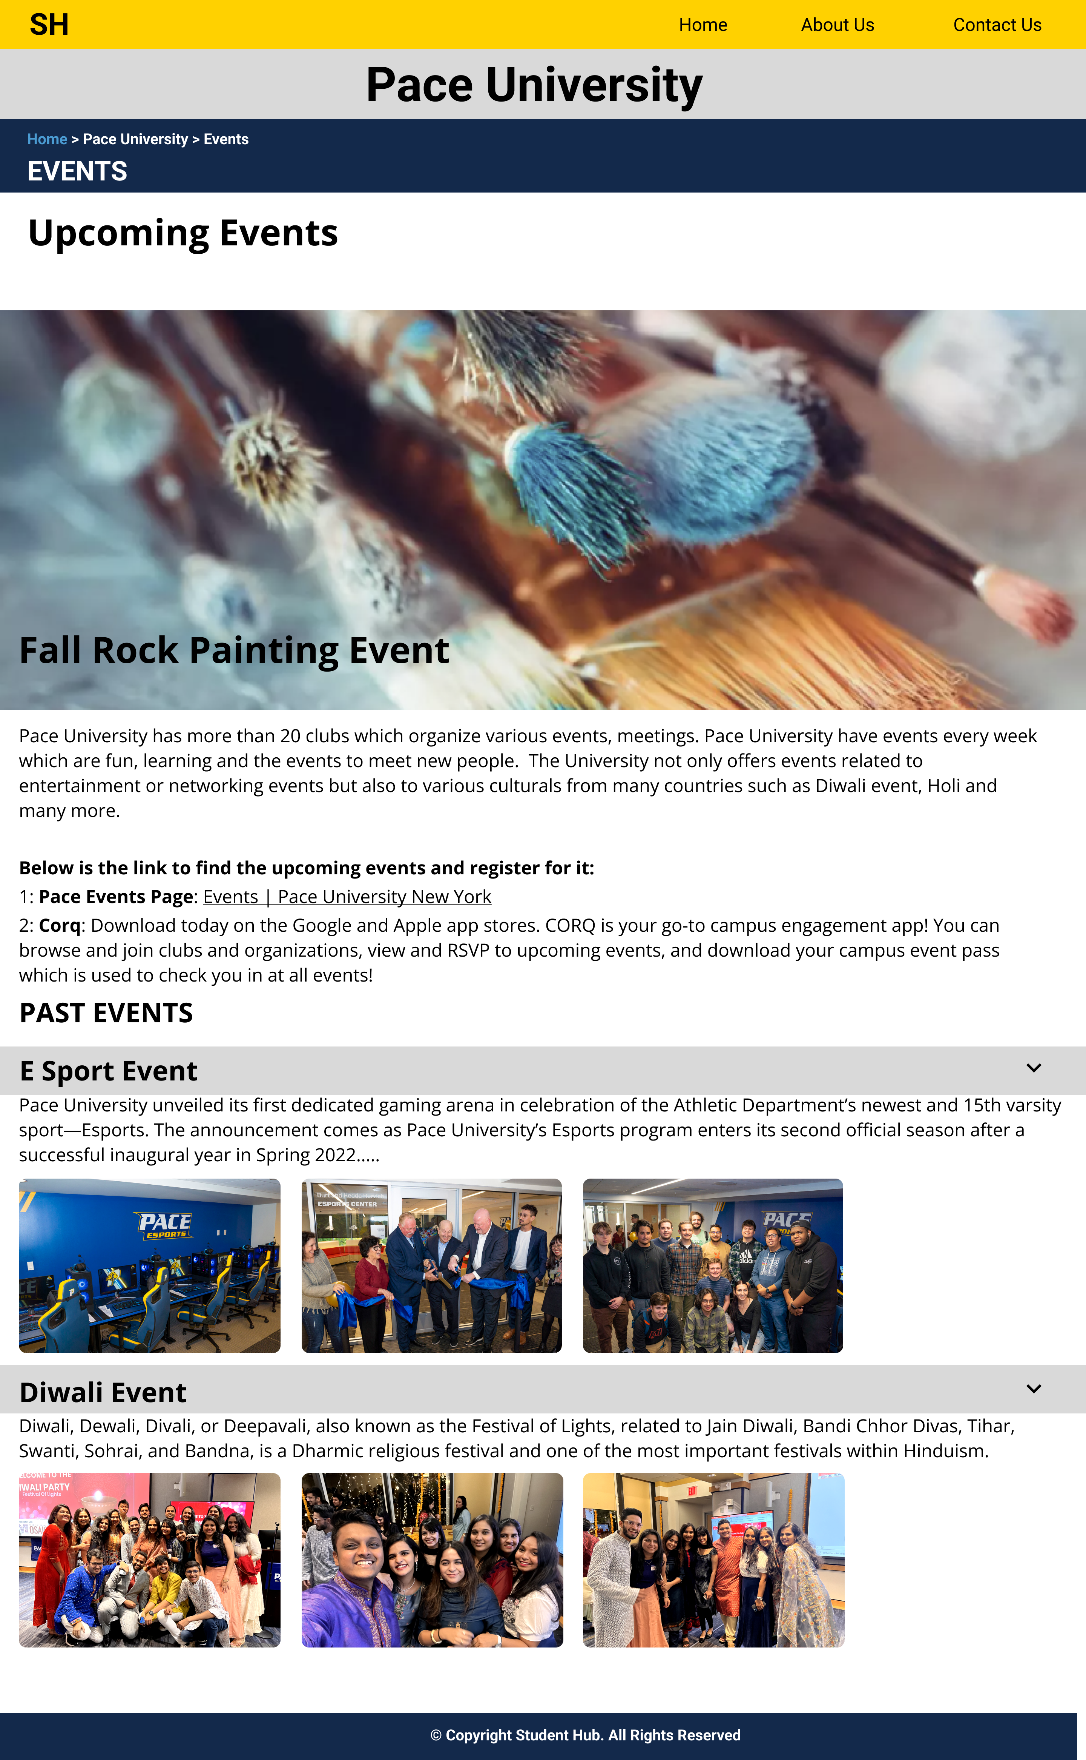
Events
The Events page consists of details about the various events organized by clubs on campus and where they can reserve it.
It consists of details of past events with few images.

Slide 15
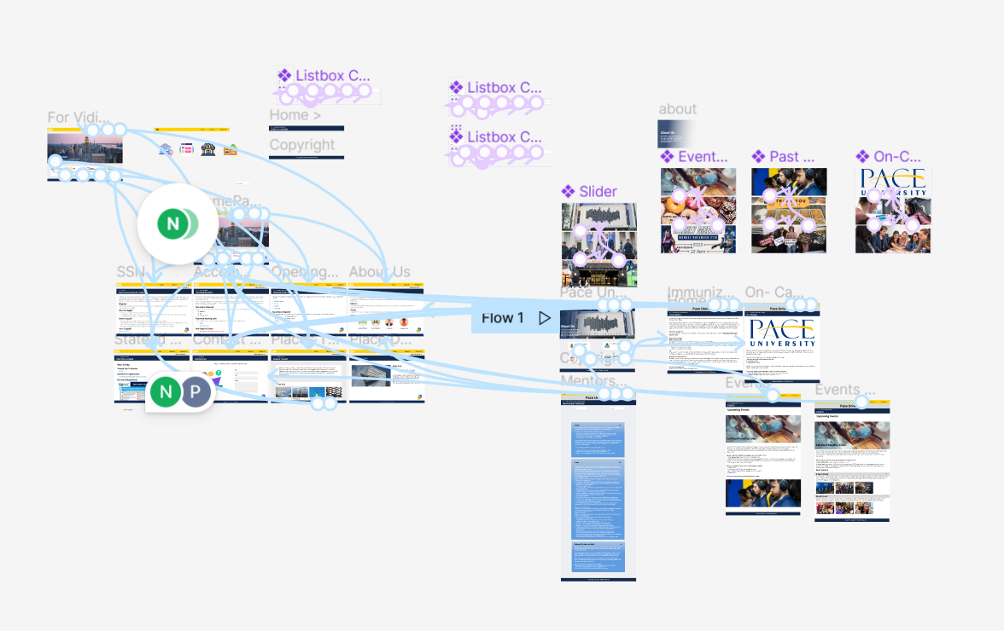

Slide 16
MOBILE VIEW

Slide 17
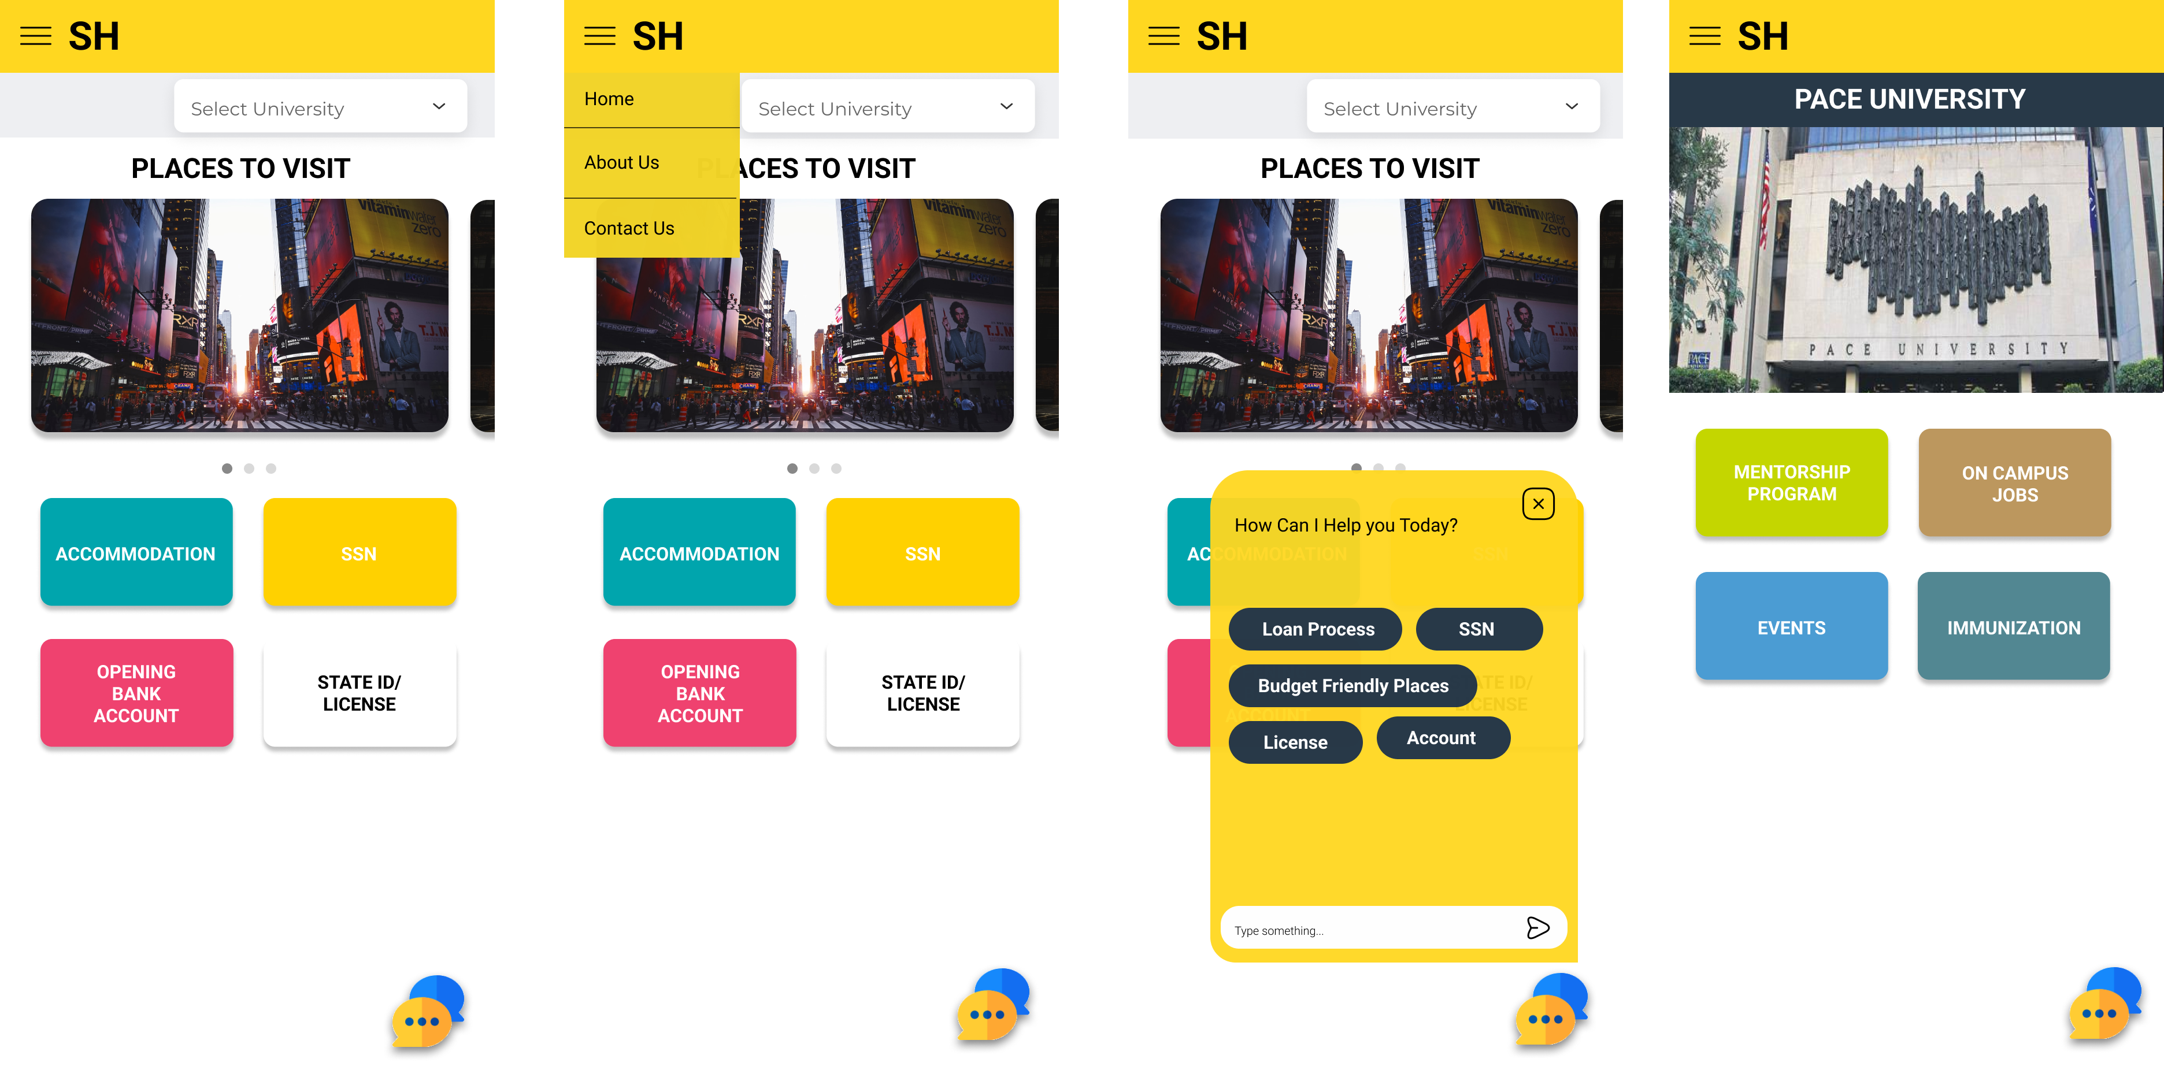
Mobile View
Since the website is agonistic, it will be accessible both on the desktop and mobile.
For the mobile view we have done few tweaks to beautify it a little and keep it light.

Slide 18
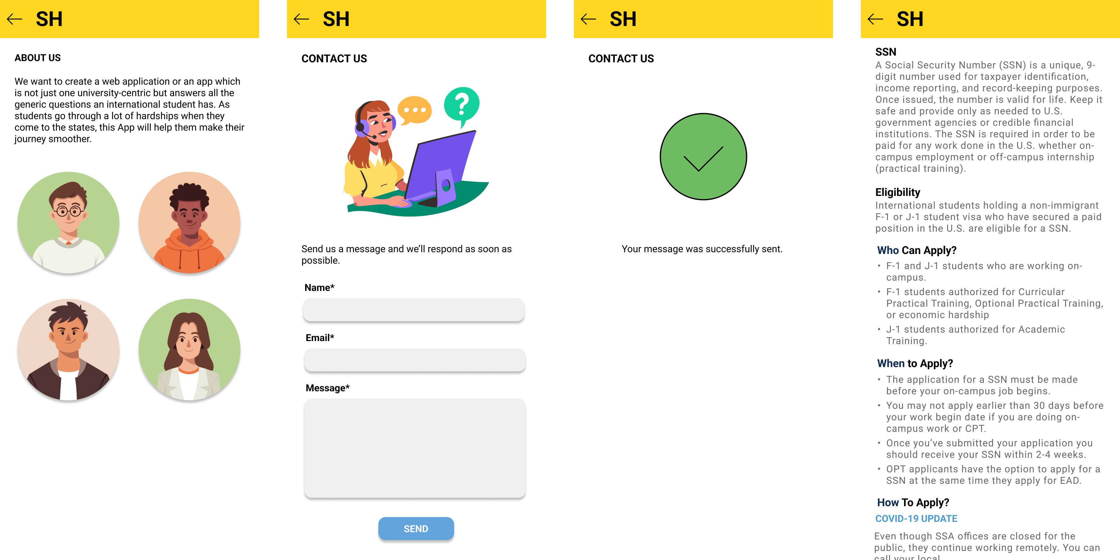

Slide 19
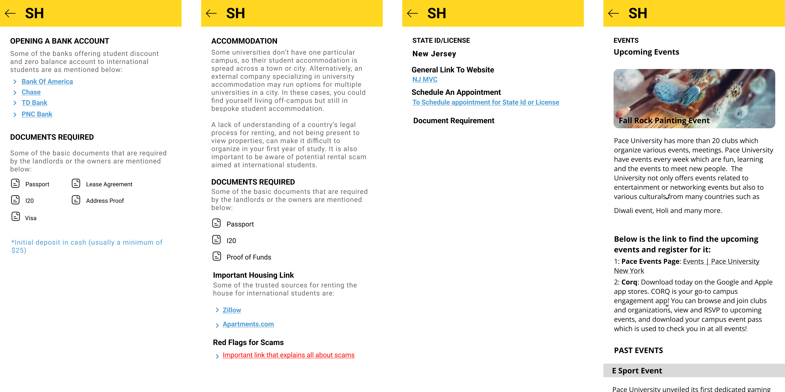

Slide 20
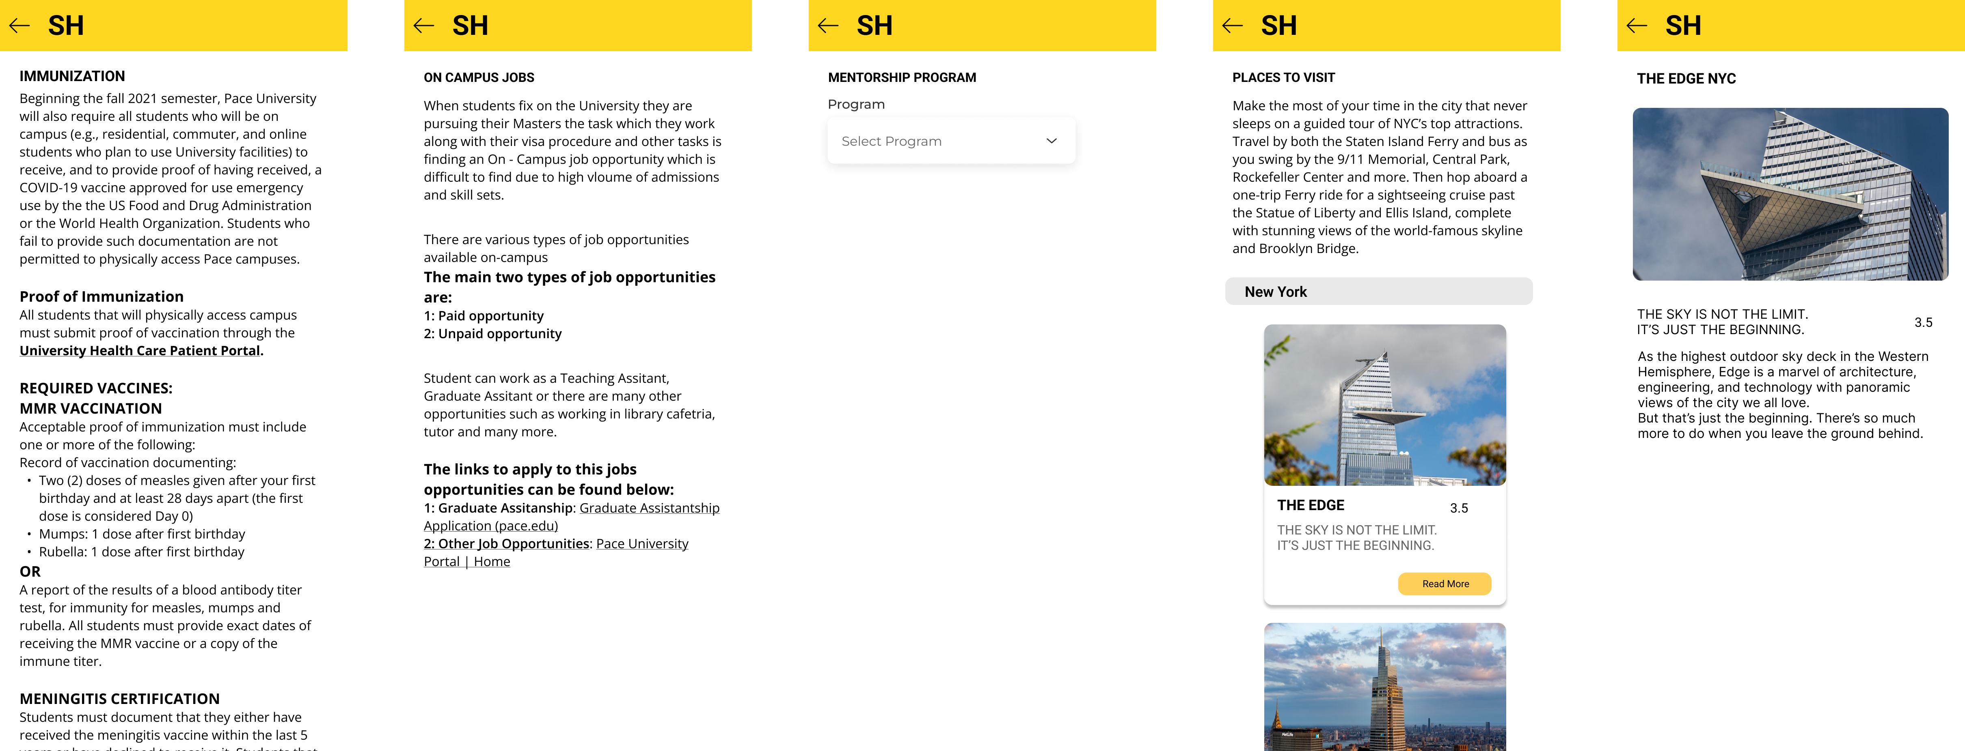

Slide 21
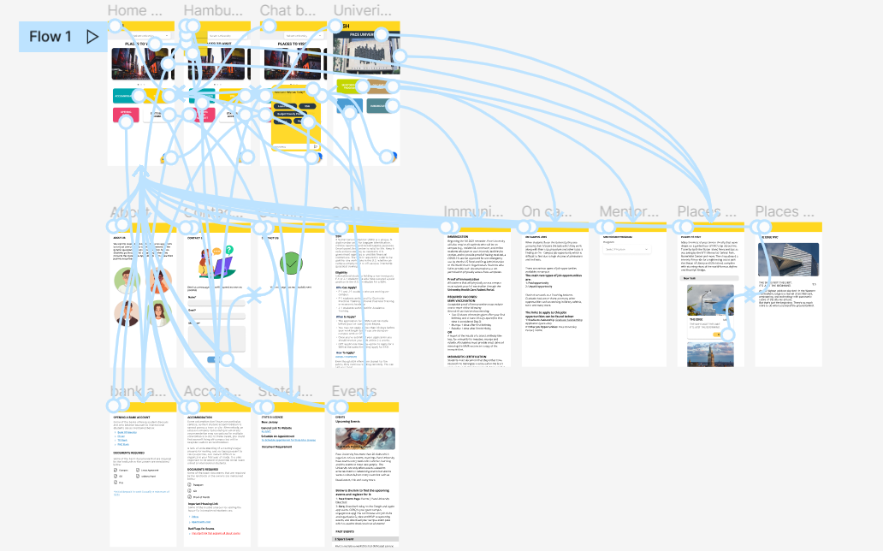
The Flow Diagram
The flow for the mobile view also remains the same only the navigation bar is converted to Hamburger menu.

Slide 22
THANK YOU

